Slide 1
Planning with Goal-Conditioned Policies
Soroush Nasiriany, Vitchyr H.Pong, Steven Lin, Sergey Levine
NIPS 2019
by Yuzhe Zhou
2025-05-16

Slide 2

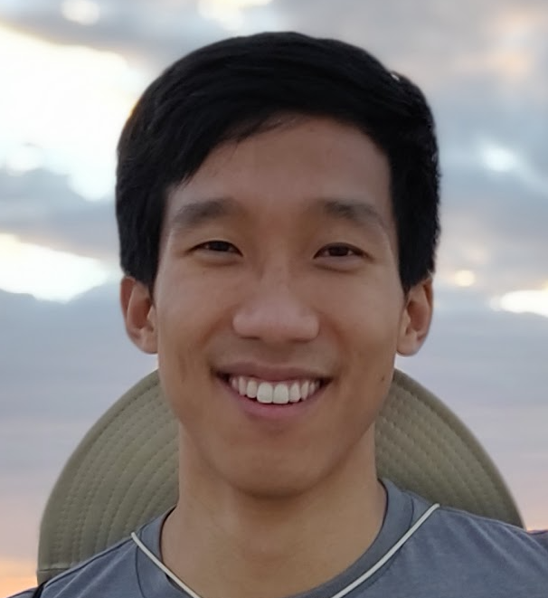
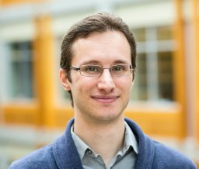
Authors
Soroush Nasiriany UC Berkeley
Machine Learning, Robotics
Vitchyr H. Pong UC Berkeley
Deep Learning, Reinforcement Learning, Robotics
Sergey Levine UC Berkeley
Machine Learning, Robotics, Reinforcement Learning

Slide 3
Motivation
Planning methods can solve temporally extended sequential decision.
Planning requires suitable abstractions for the states and transitions.
RL can acquire behaviors from low-level inputs directly.
RL often struggles with temporally extended tasks.
A method for combining model-free RL for short-horizon goal-reaching with model-based planning.
The method can flexibly plan to solve new tasks.

Slide 4
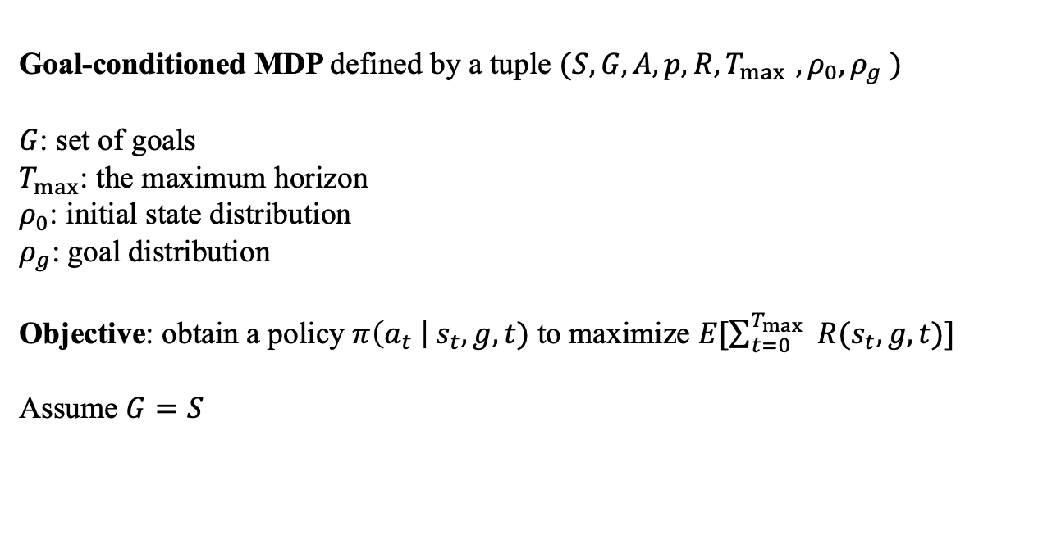
Goal-Conditioned MDP
Goal-conditioned MDP defined by a tuple $(S,G,A,p,R,T_{\max{ }},ρ_{0},ρ_{g} )$
$G$: set of goals
$T_{max}$: the maximum horizon
$ρ_{0}$: initial state distribution
$ρ_{g}$: goal distribution
Objective: obtain a policy $π\left(a_{t} \right| s_{t}, g, t)$ to maximize $E[\sum_{t=0}^{T_{\max{ }}}{R(s_{t},g,t)}]$
Assume $G=S$

Slide 5
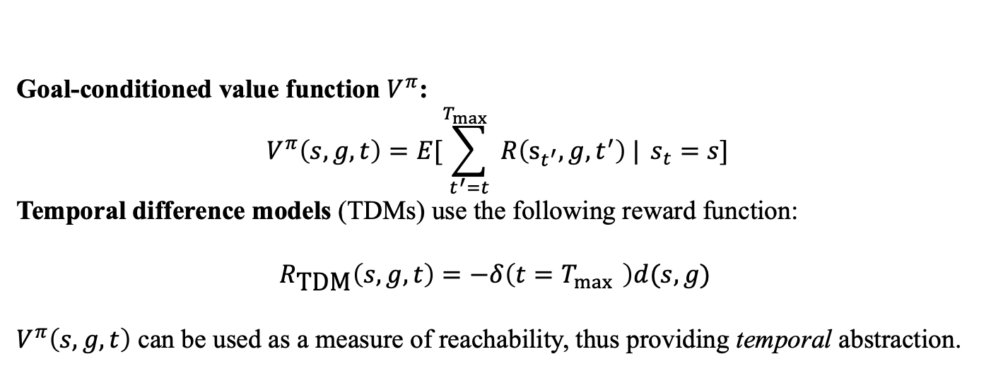
Goal-Conditioned MDP
Goal-conditioned value function $V^{π}$:
$$V^{π}\left(s,g,t\right)=E[\sum_{t^{′}=t}^{T_{\max{ }}}{R\left(s_{t^{′}},g,t^{′}\right) |} s_{t}=s]$$
Temporal difference models (TDMs) use the following reward function:
$${R_{\text{TDM}}\left(s,g,t\right)=−δ\left(t=T_{\max{ }}\right)d(s,g)}_{ }$$
$V^{π}\left(s,g,t\right)$ can be used as a measure of reachability, thus providing temporal abstraction.
Notes:
Goal-conditioned MDP的一个比较重要的概念是goal-conditioned value function,给定当前的状态、目标和时间步预测未来的累积reward
从奖励函数的形式可以看出奖励是和时间步有关的，T_max的最大时间步限制，当从当前state至少需要经过大于T_max步决策才能到达goal时，Reward一定是负数
由于V值是未来reward的累积，所以V有个比较好的性质，就是可以反映s与g之间的reachability，当s和g足够接近，V值就会更大，当V值为0时说明s在T_max时间步内能到达g，因此V可以作为两个状态之间的距离度量

Slide 6
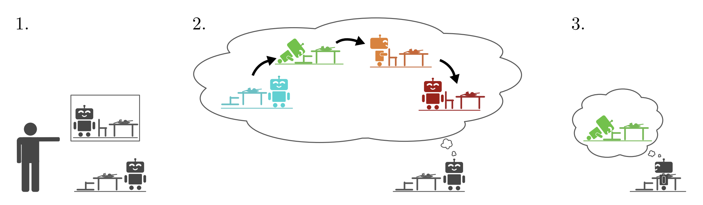
Latent Embeddings for Abstracted Planning
The planner is given a goal state
The planner plans intermediate subgoals in a low-dimensional latent space
The goal-conditioned policy then tries to reach the first goal

Slide 7
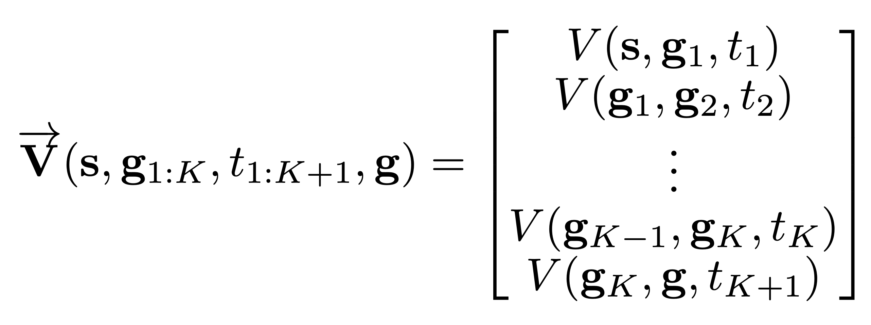
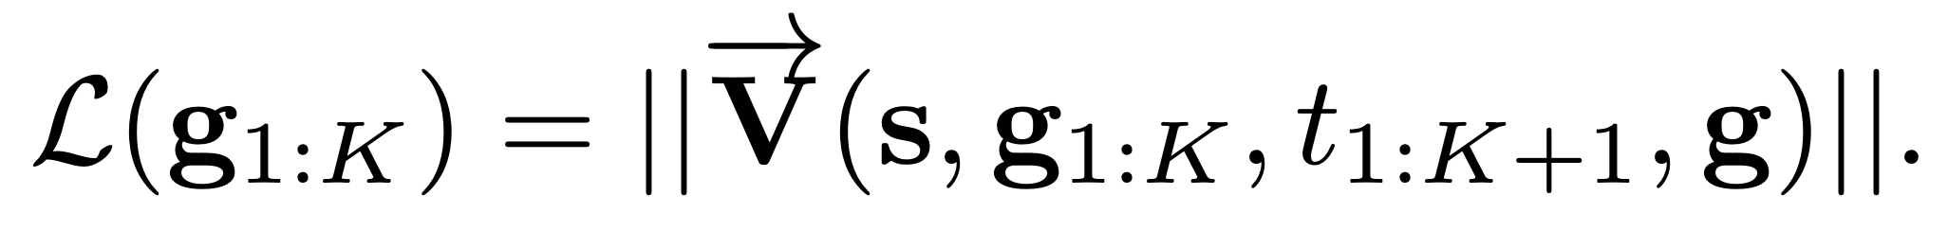
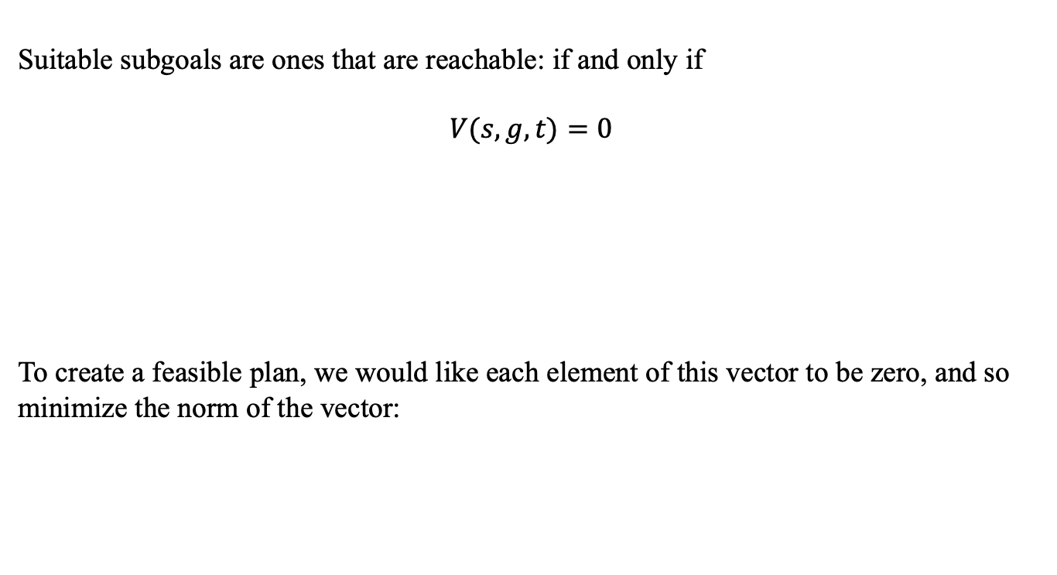
Planning over Subgoals
Suitable subgoals are ones that are reachable: if and only if
$$V(s,g,t)=0$$
To create a feasible plan, we would like each element of this vector to be zero, and so minimize the norm of the vector:
Notes:
我们以向量的形式表示这个k个subgoals之间的V值，每个元素代表两个subgoal之间的reachaility。现在优化目标是尽可能使这个向量的范数为0

Slide 8
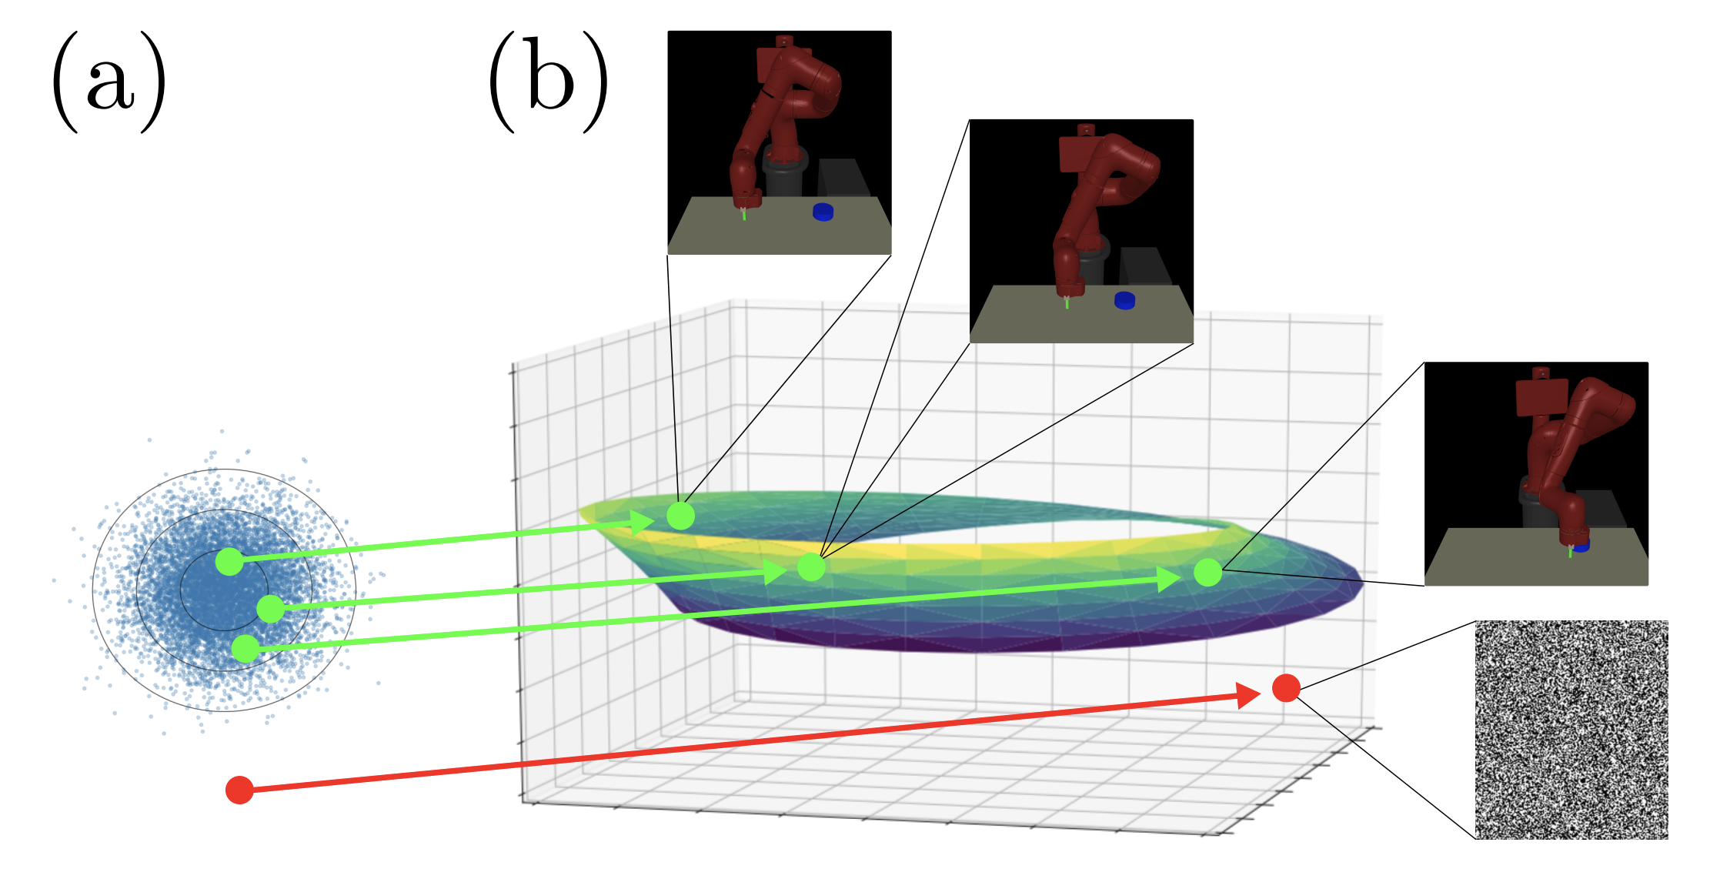
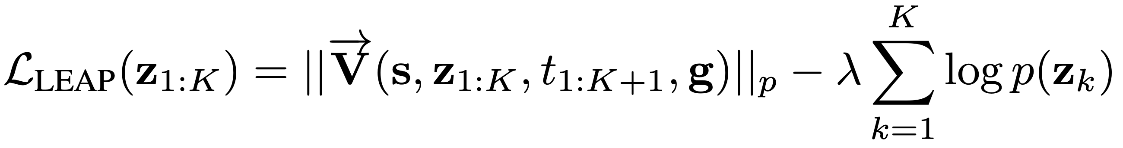
Optimizing over Images
Solving optimization presents two problems:
High-dimensional
TDMs will only produce reasonable reachability for valid goals.
A VAE is used to train with images randomly sample from the environment.

Slide 9
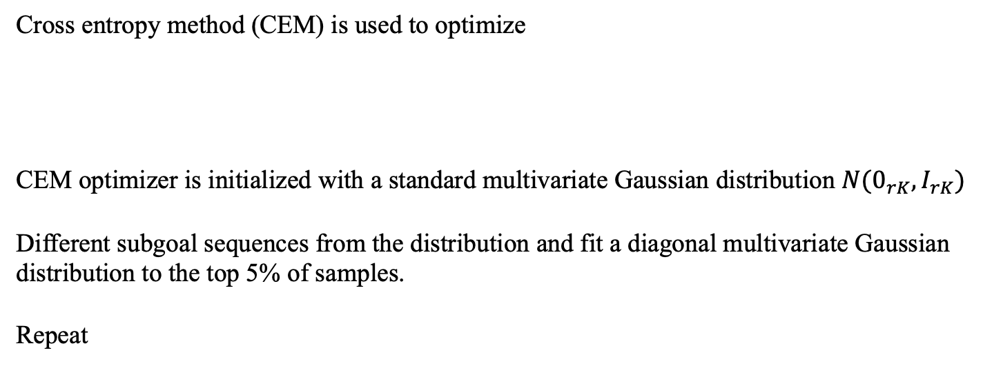
Latent Space Optimization
Cross entropy method (CEM) is used to optimize
CEM optimizer is initialized with a standard multivariate Gaussian distribution $N(0_{rK},I_{rK})$
Different subgoal sequences from the distribution and fit a diagonal multivariate Gaussian distribution to the top 5% of samples.
Repeat

Slide 10
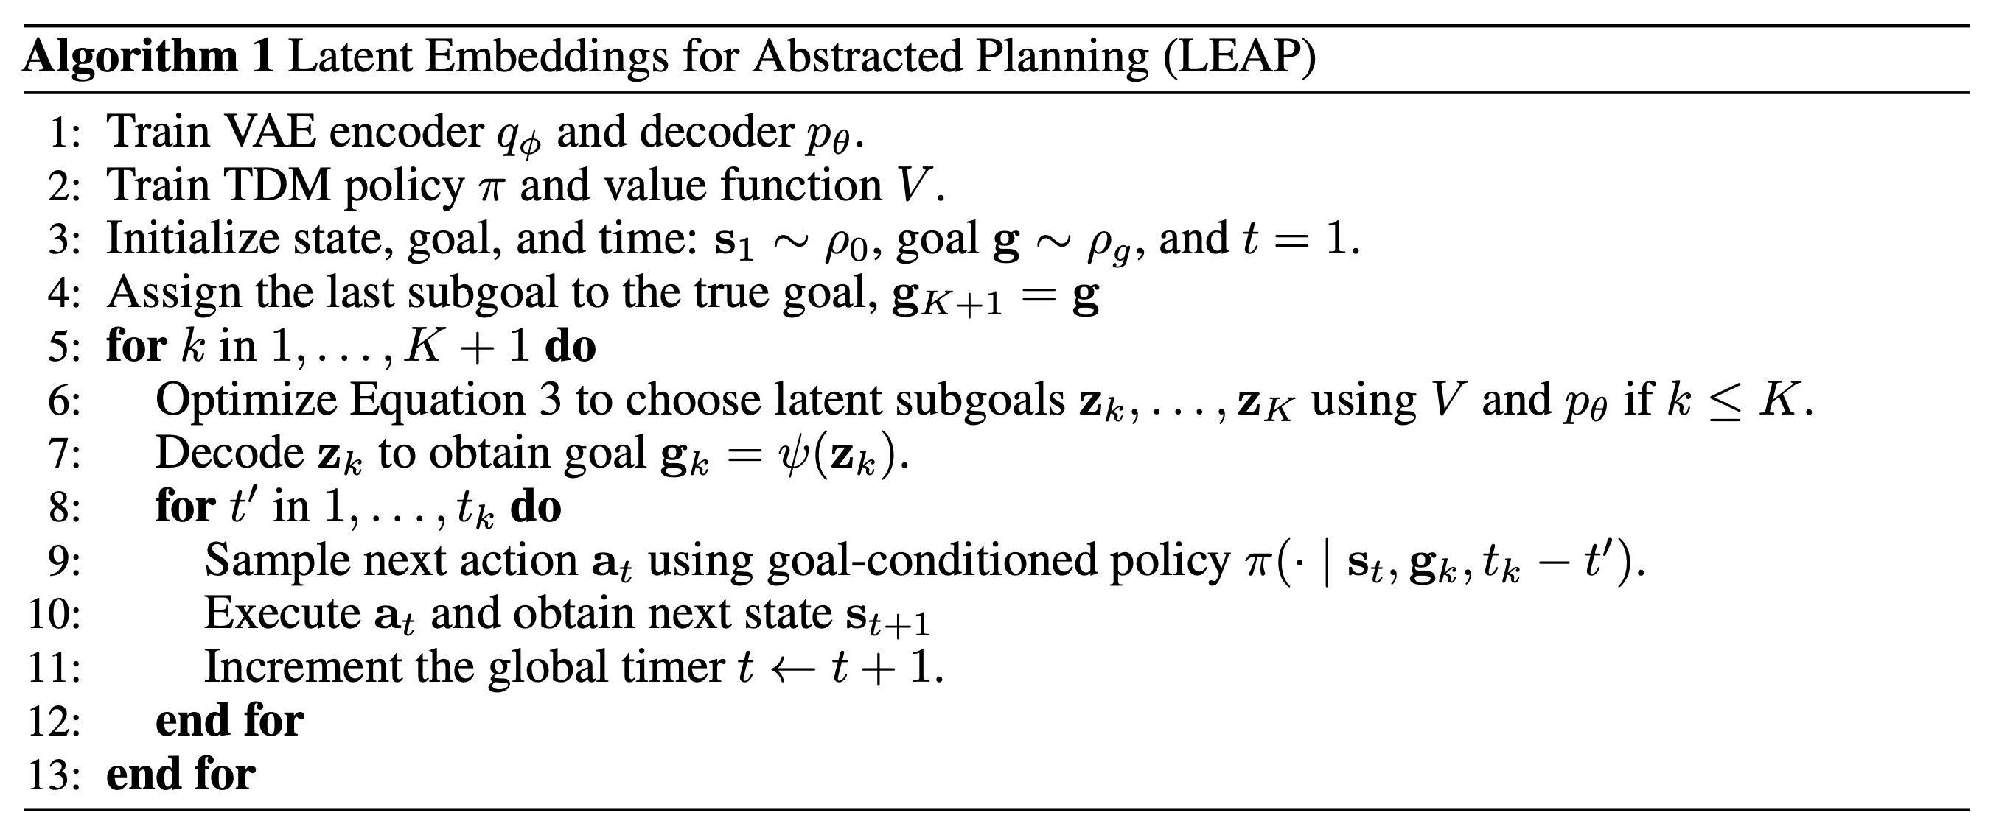
Algorithm

Slide 11
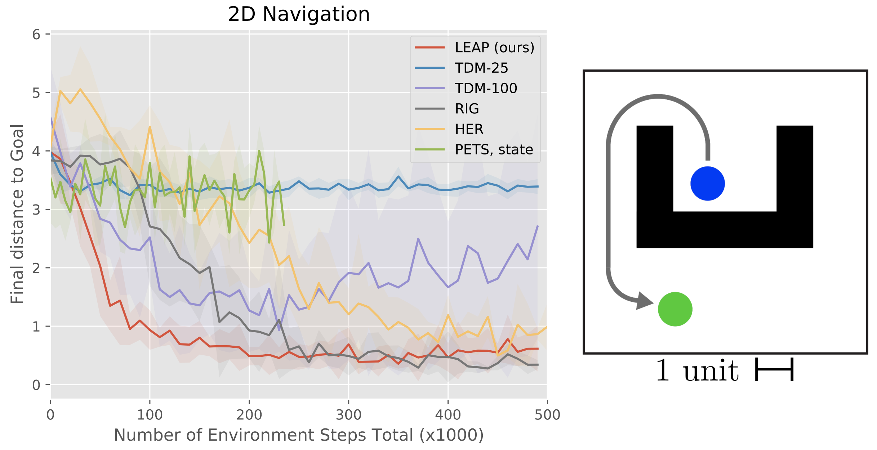
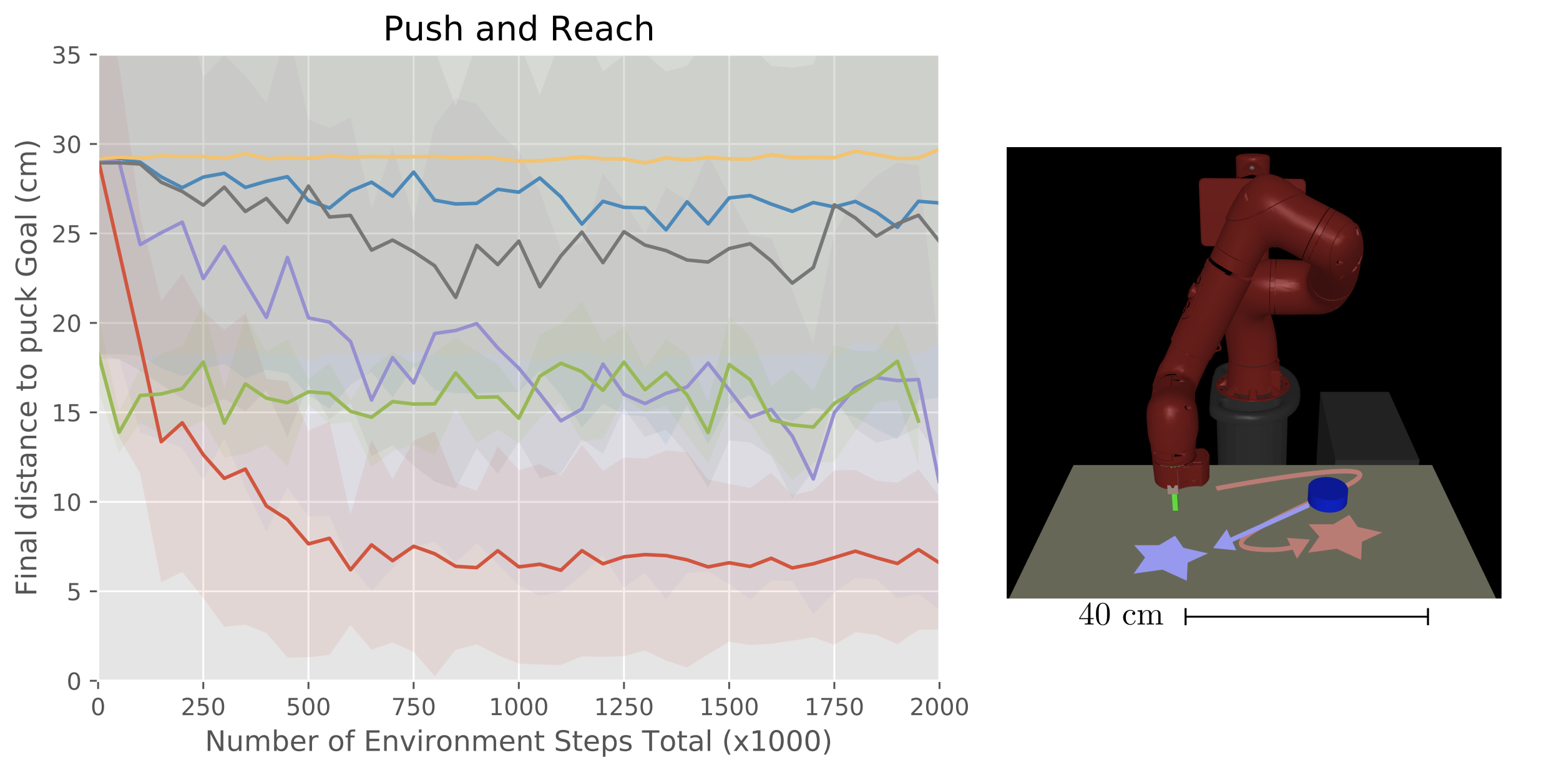
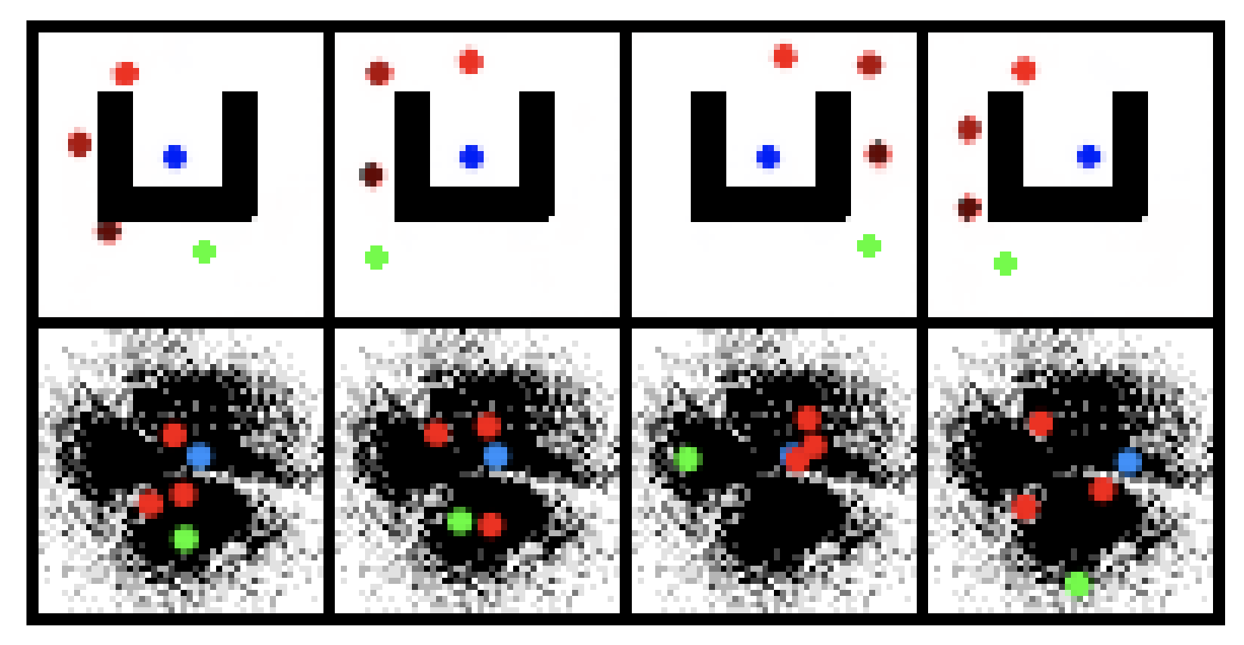
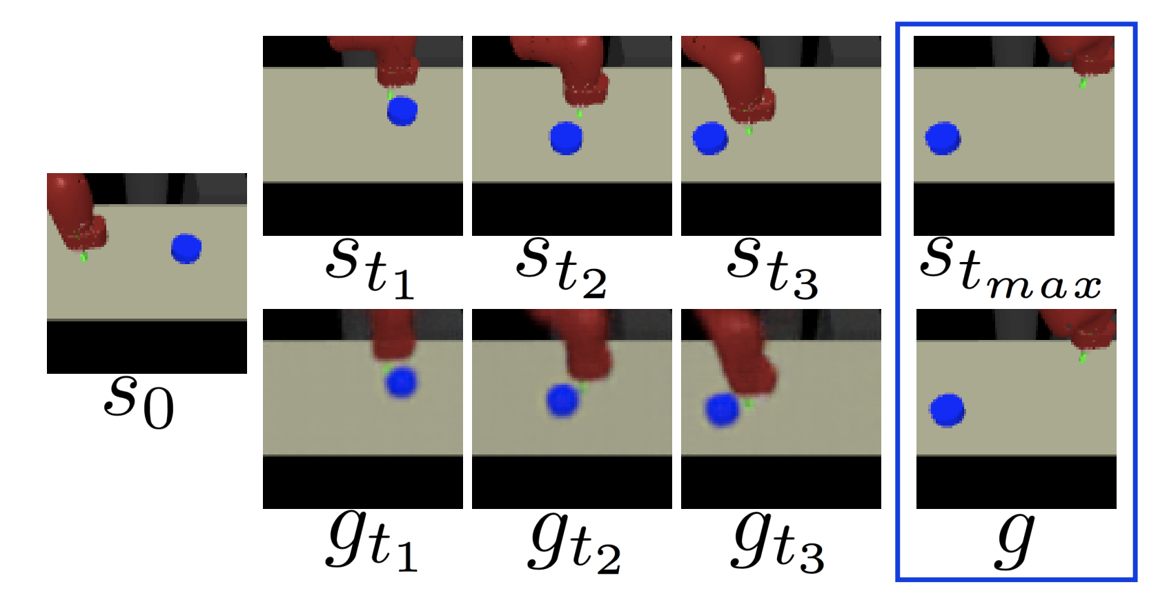
Experiment

Slide 12
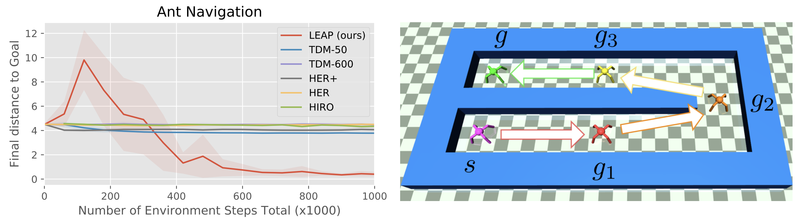
Experiment

Slide 13
Search on the Replay Buffer: Bridging Planning and Reinforcement Learning

Slide 14
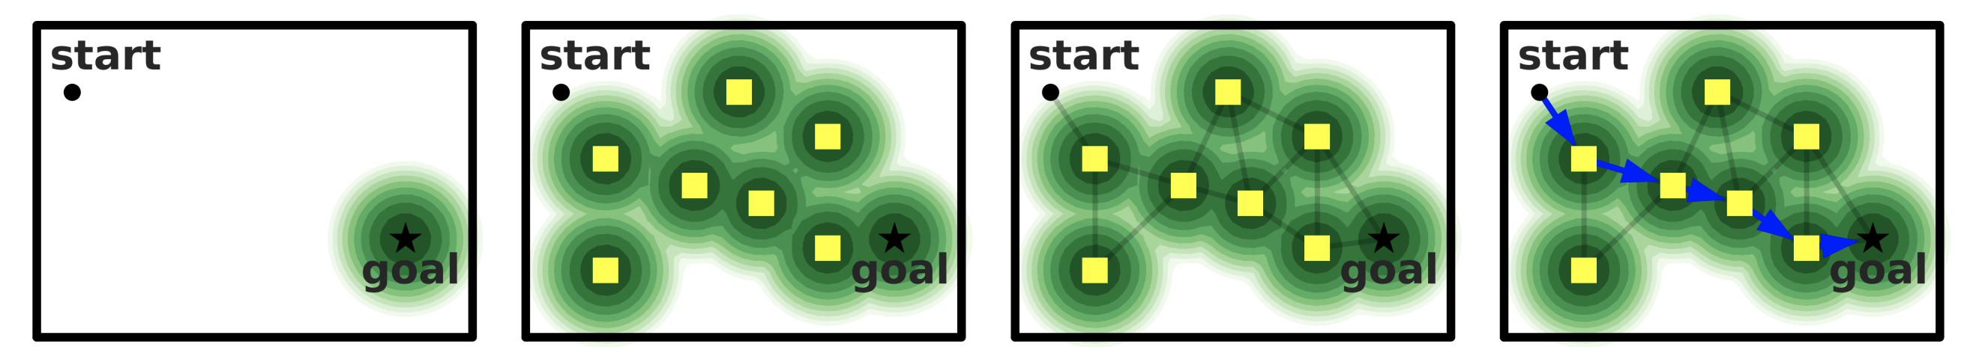
Overview

Slide 15
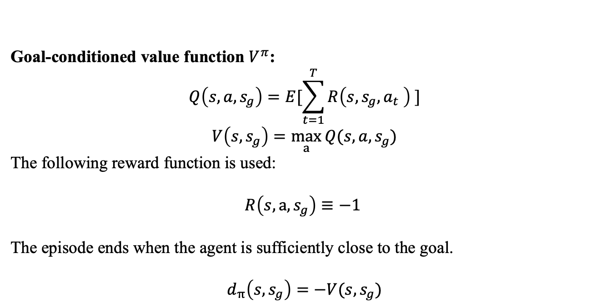
Distance Metric
Goal-conditioned value function $V^{π}$:
$$Q\left(s,a,s_{g}\right)=E[\sum_{t=1}^{T}{R\left(s,s_{g},a_{t} \right) }]$$
$$V\left(s,s_{g}\right)=\max_{a}{Q(s,a,s_{g})}$$
The following reward function is used:
$${R\left(s,a,s_{g}\right)≡−1}_{ }$$
The episode ends when the agent is sufficiently close to the goal.
$$d_{π}\left(s,s_{g}\right)=−V(s,s_{g})$$
Notes:
当state和目标state足够接近时，V会更大

Slide 16
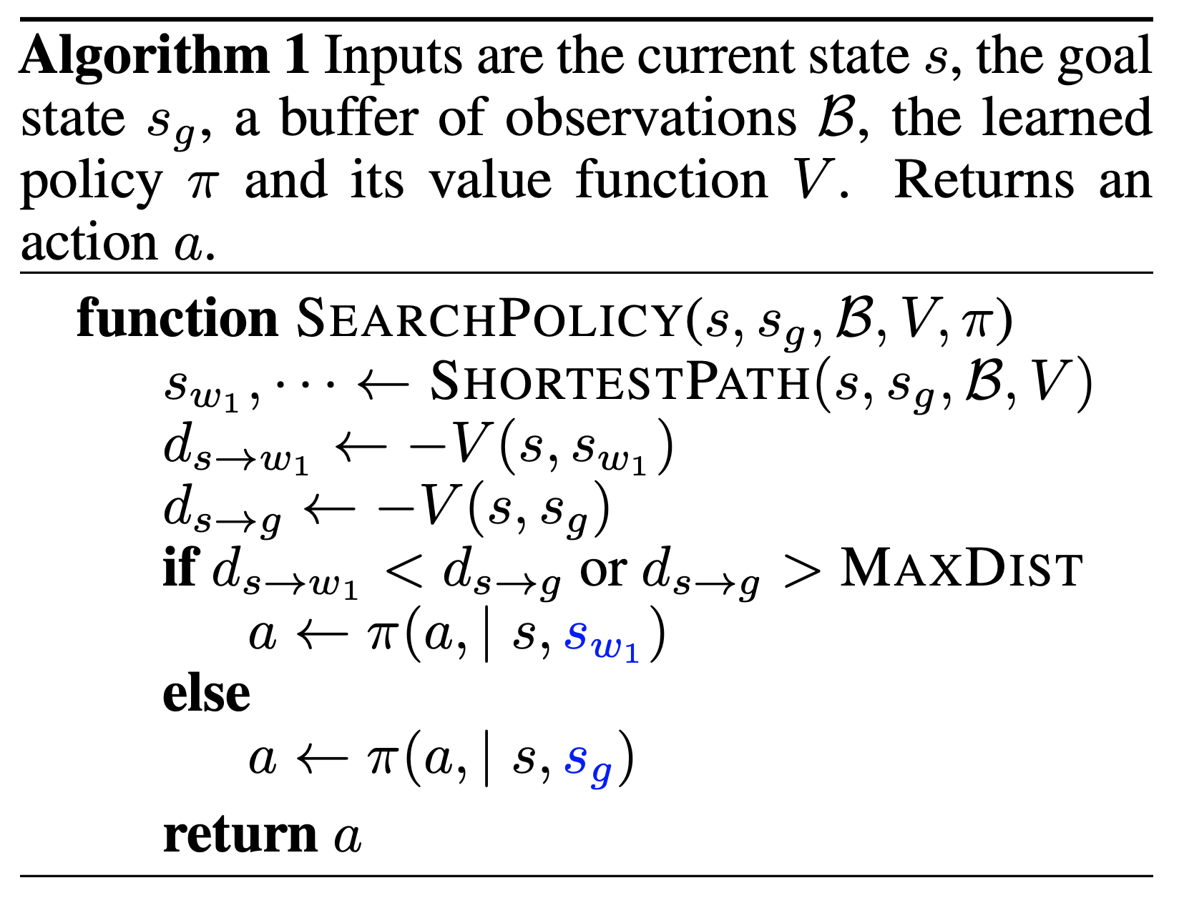
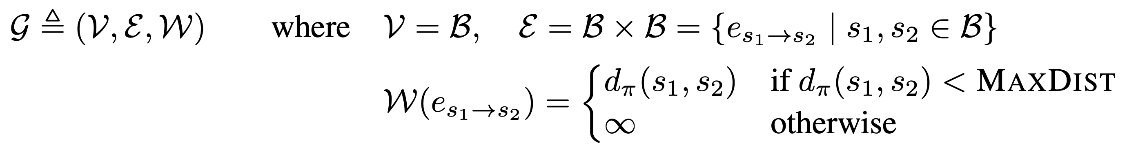
The Replay Buffer as a Graph
Notes:
这样能保证只要两个节点之间存在边，那它们对应的state距离也是相近的

Slide 17
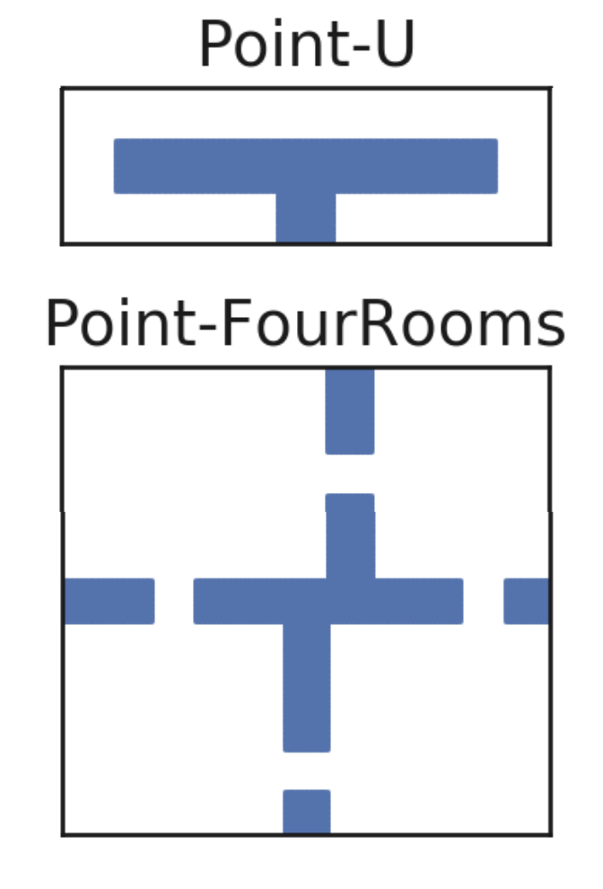
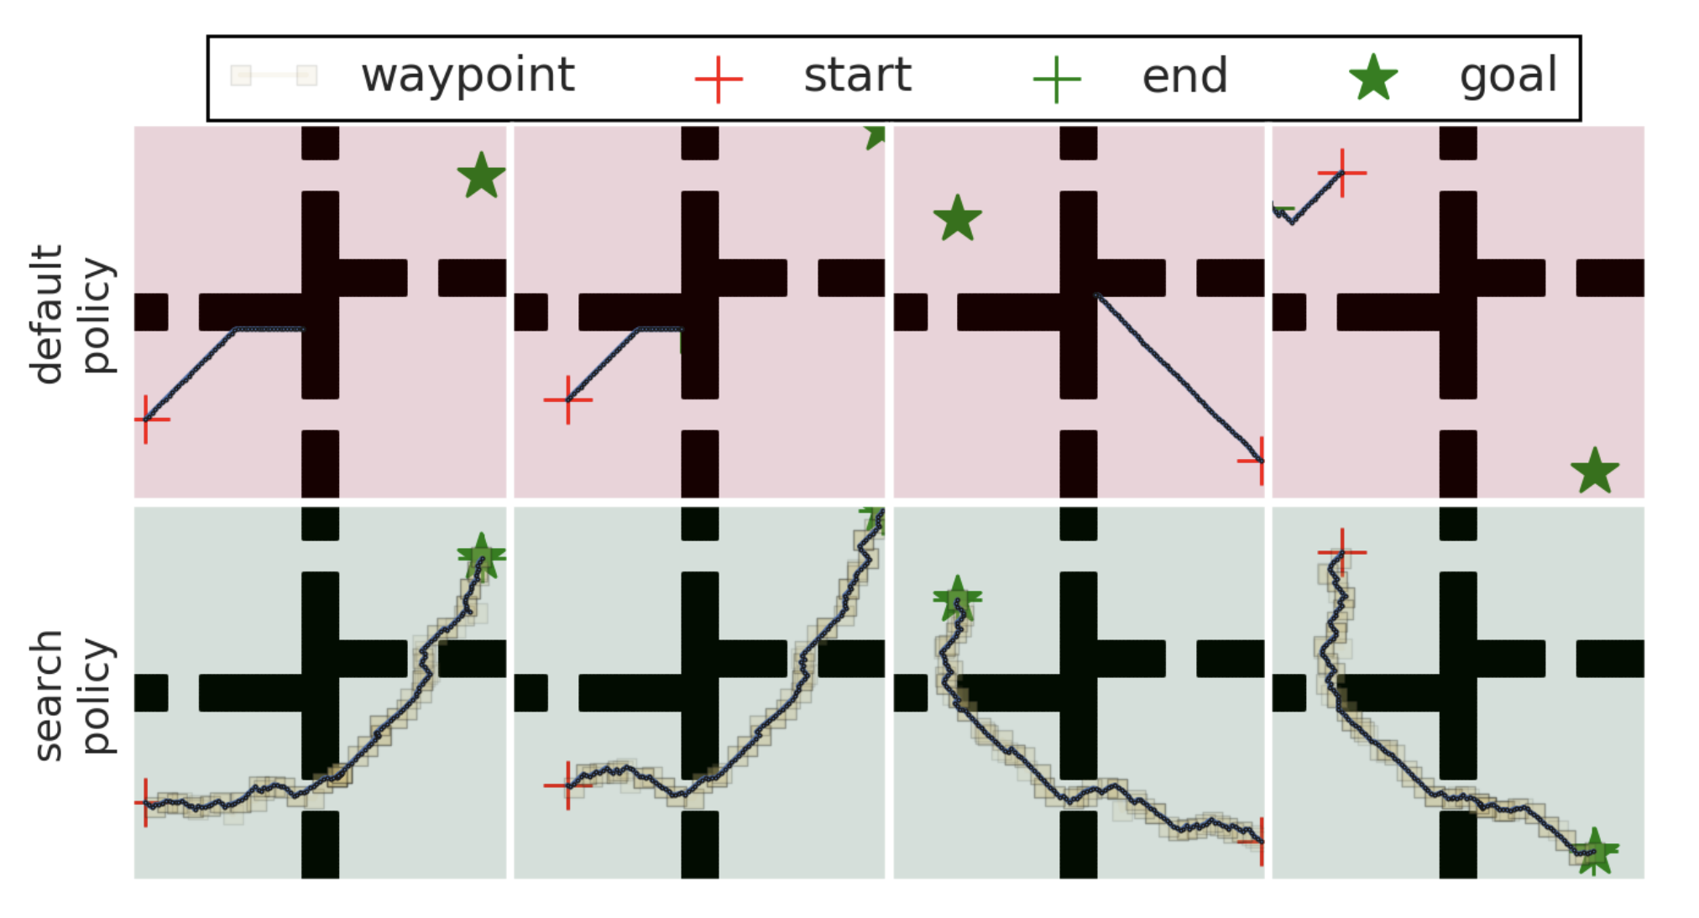
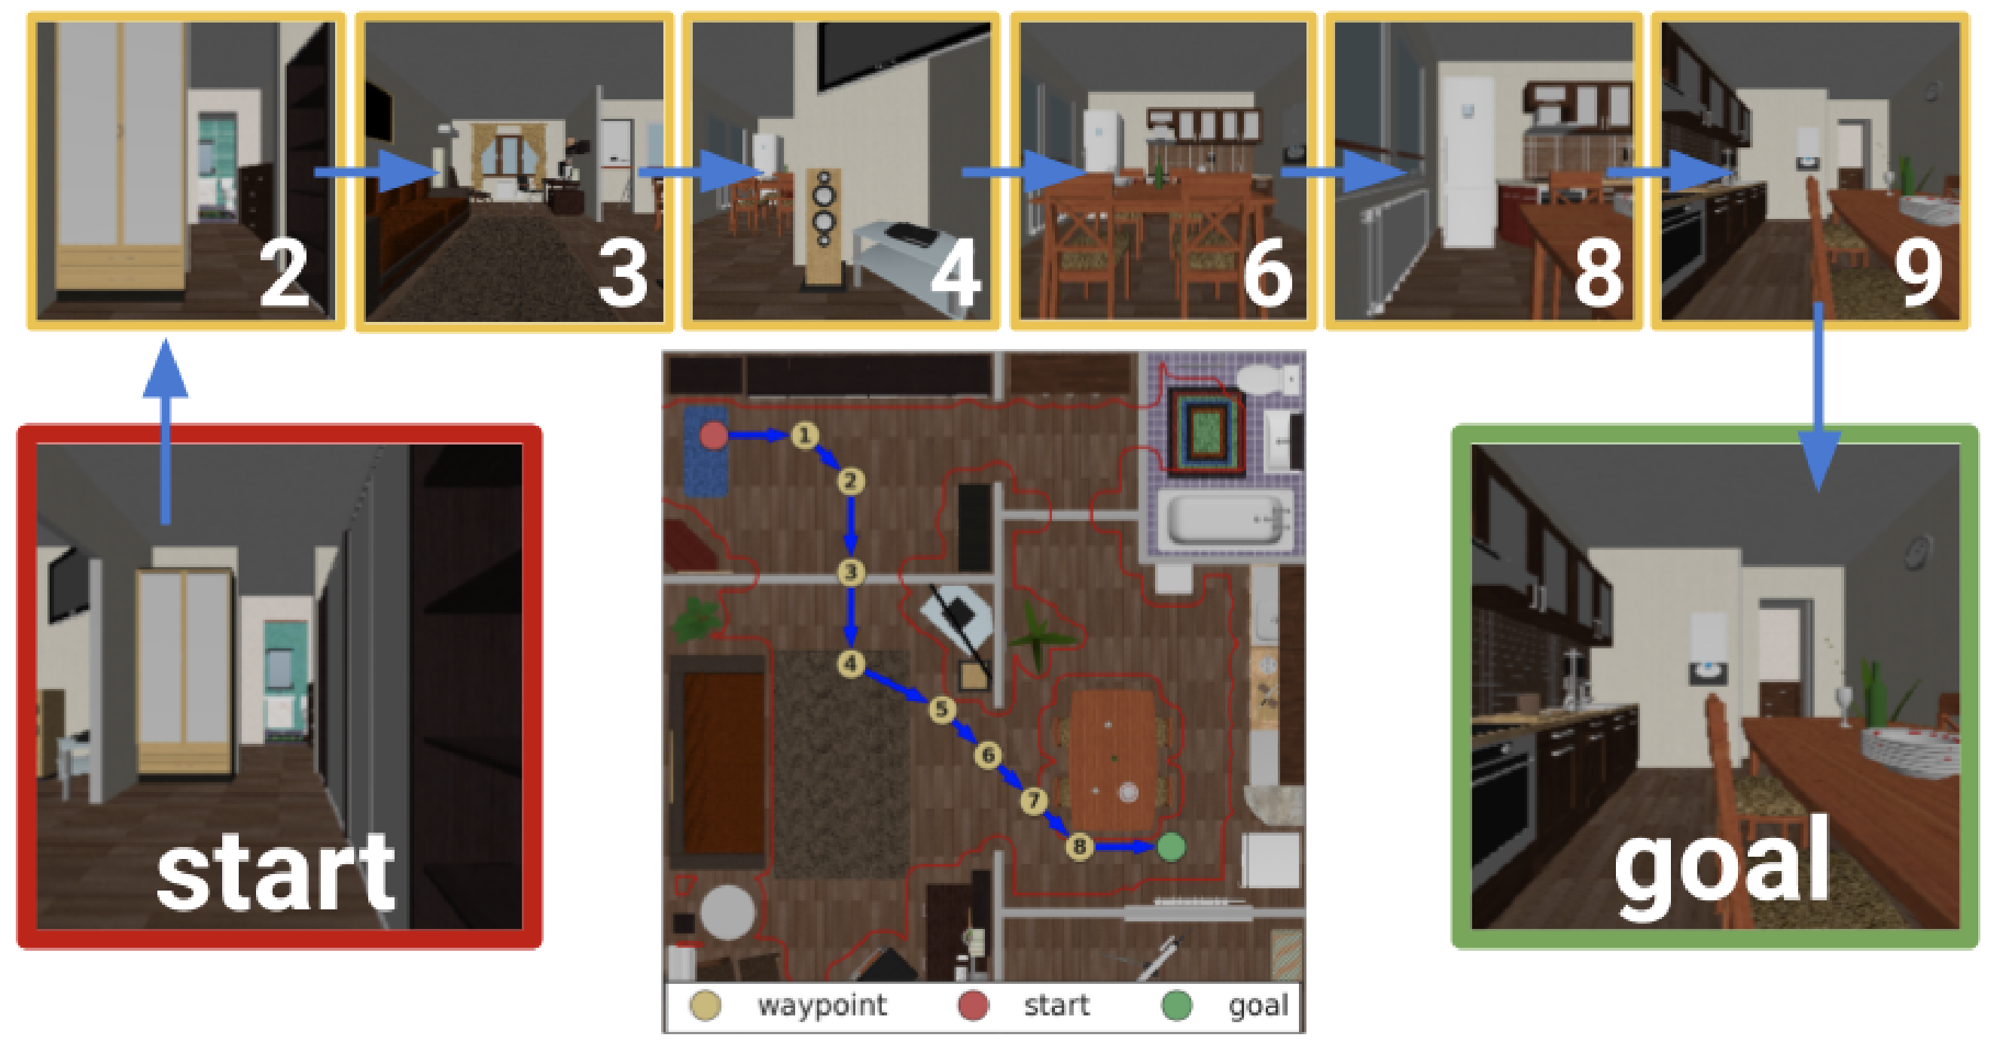
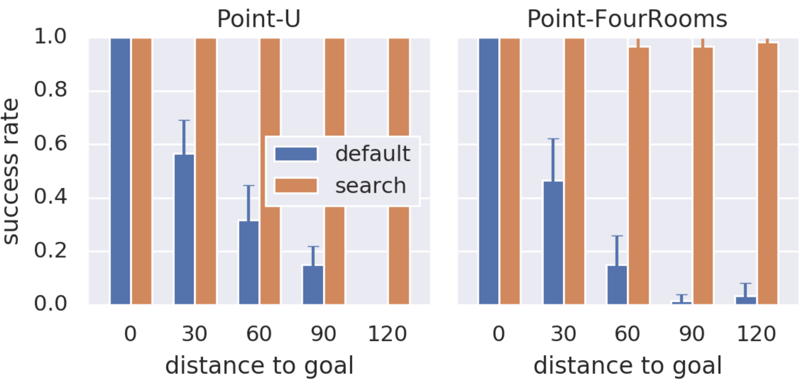
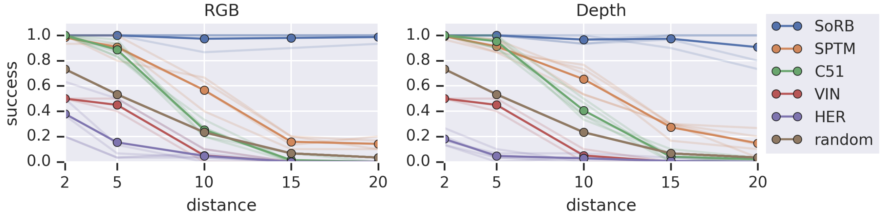
Experiment

Slide 18
Summary
Goal-Conditioned RL
Planning based on data from raw representations
The experiment is relatively simple

